Slide 1
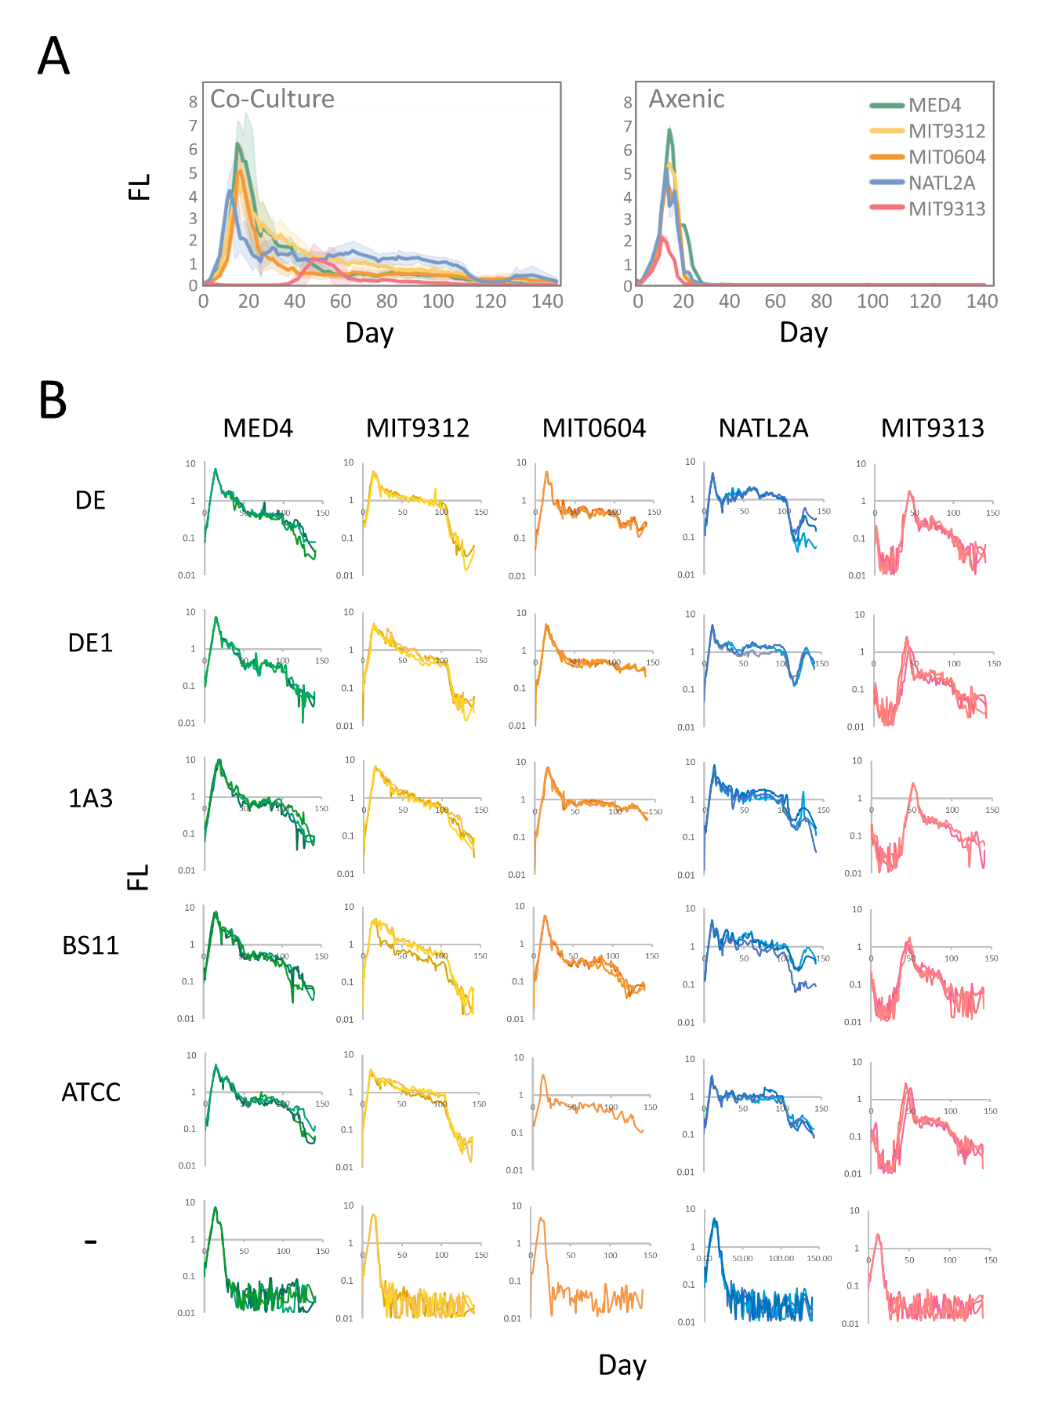
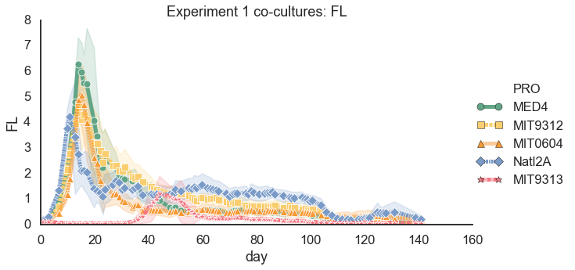
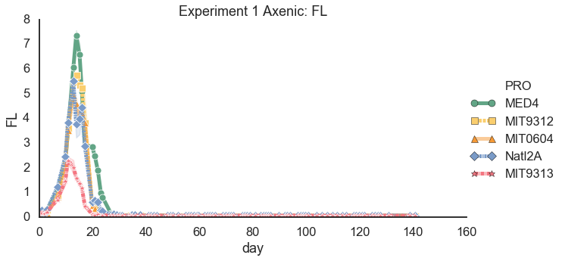
Figure 1
I added markers to the plots – see if you want to use this.

Slide 2
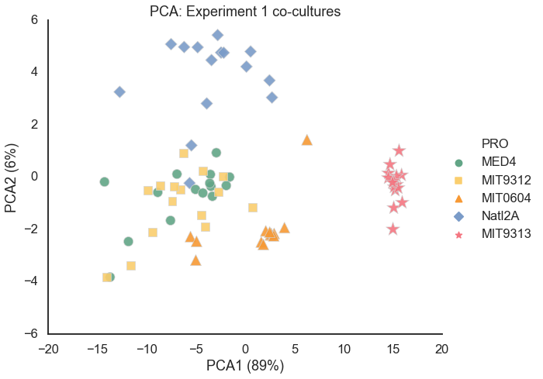
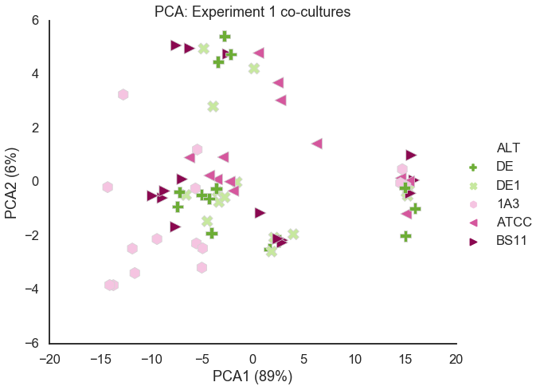
Figure 2

Slide 3
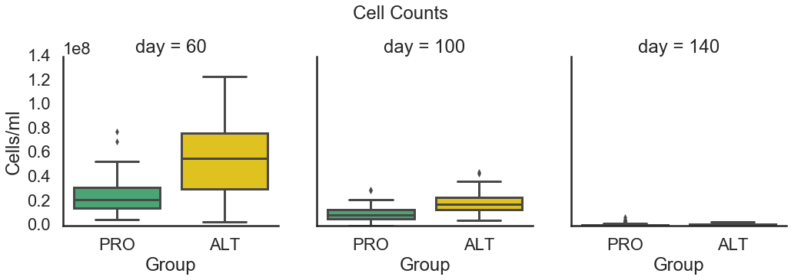
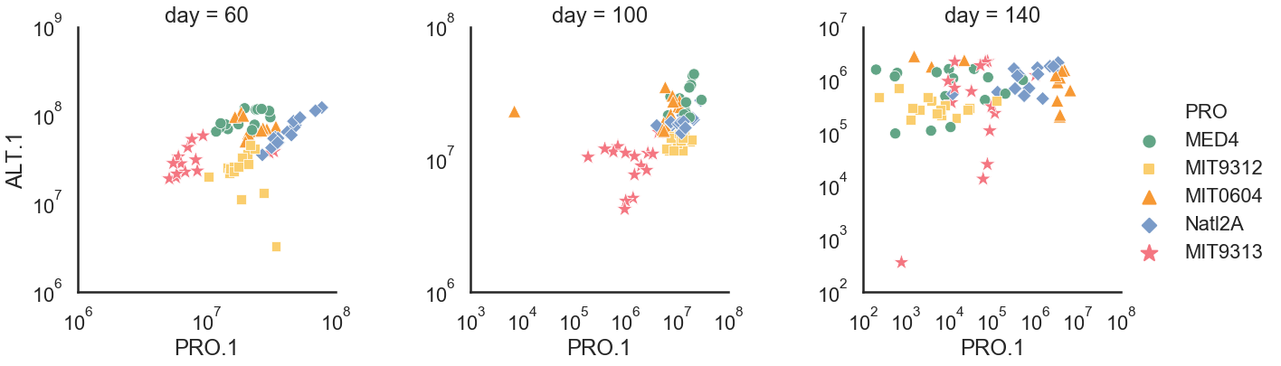
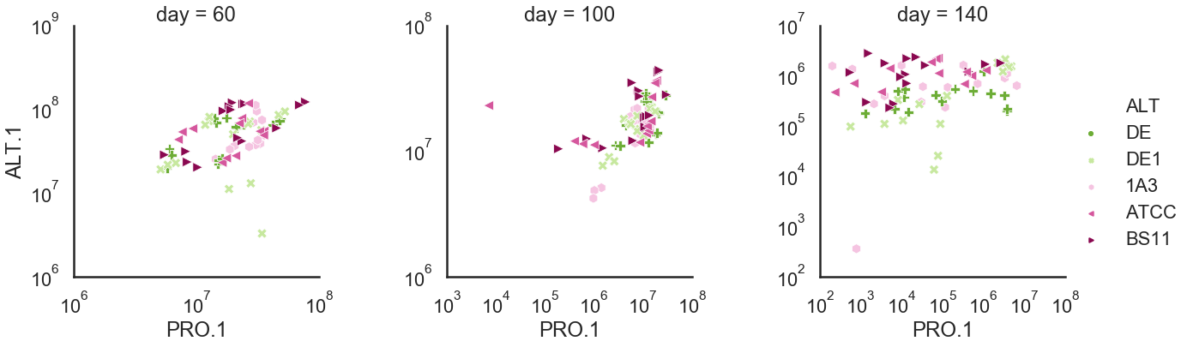
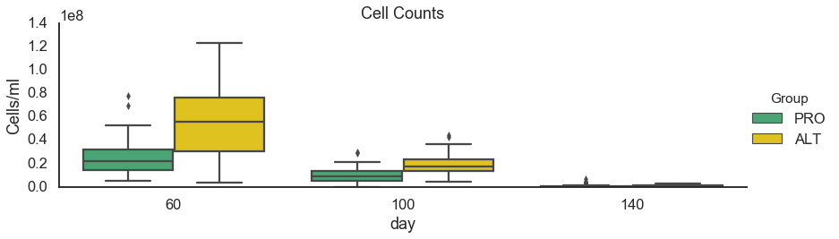
Figure 3:

Slide 4
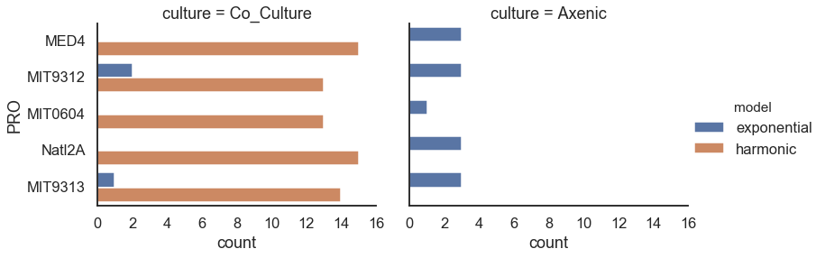
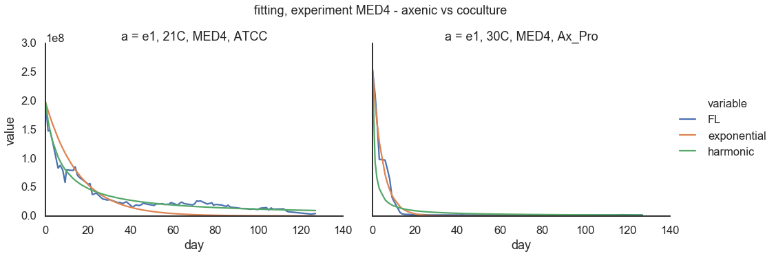
Figure 4

Slide 5
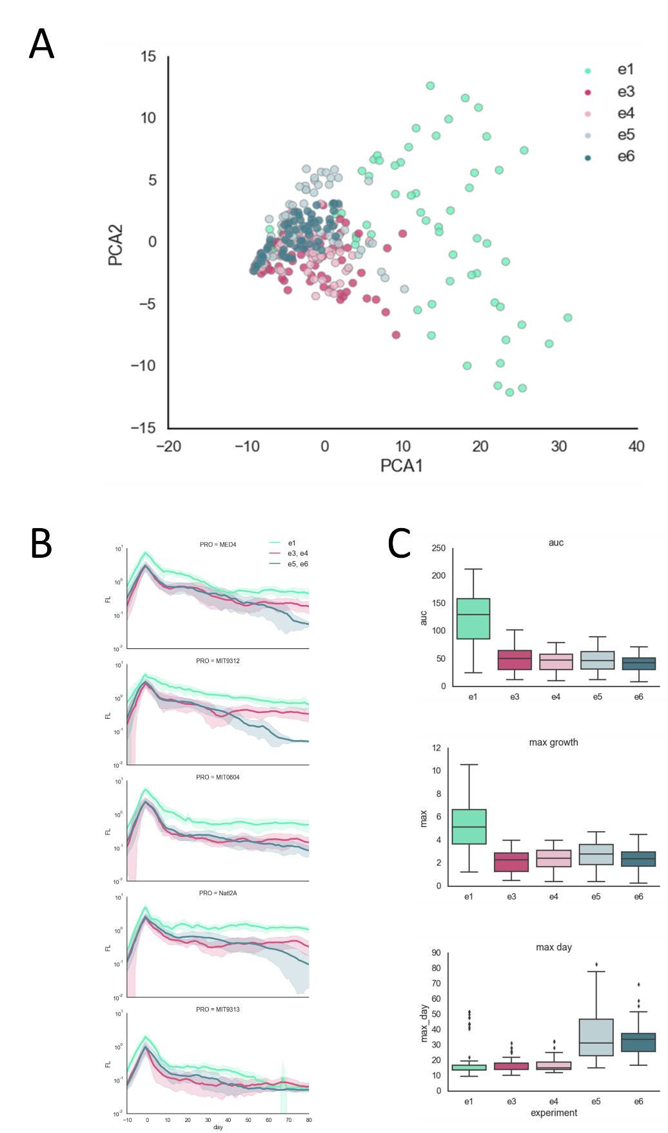
Figure 5. experiment 1 compare to 3&4 and 5&6

Slide 6
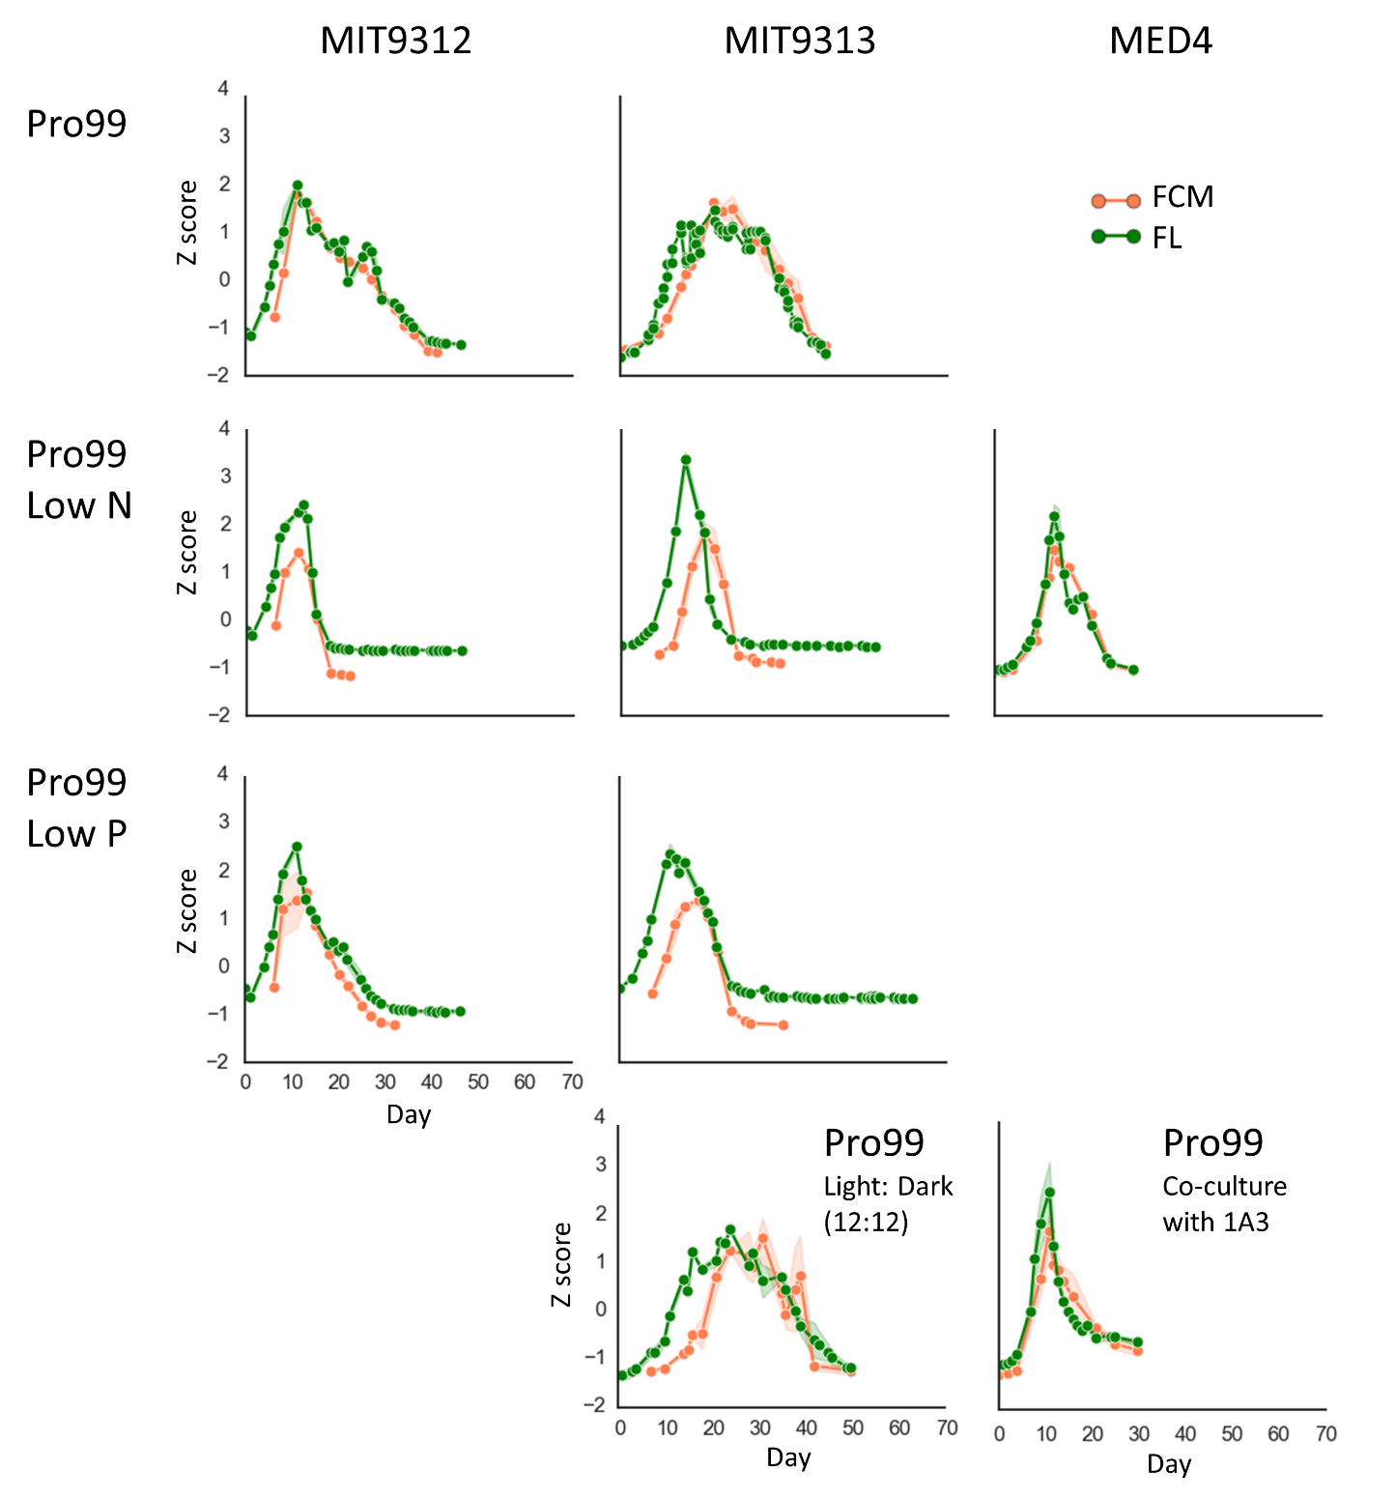
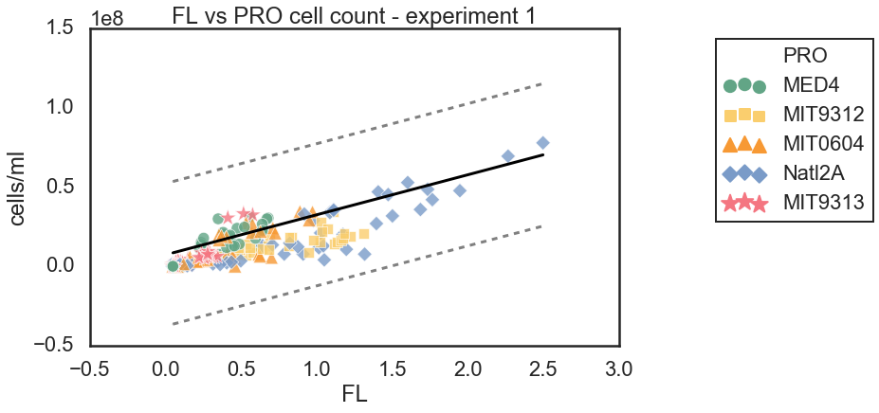
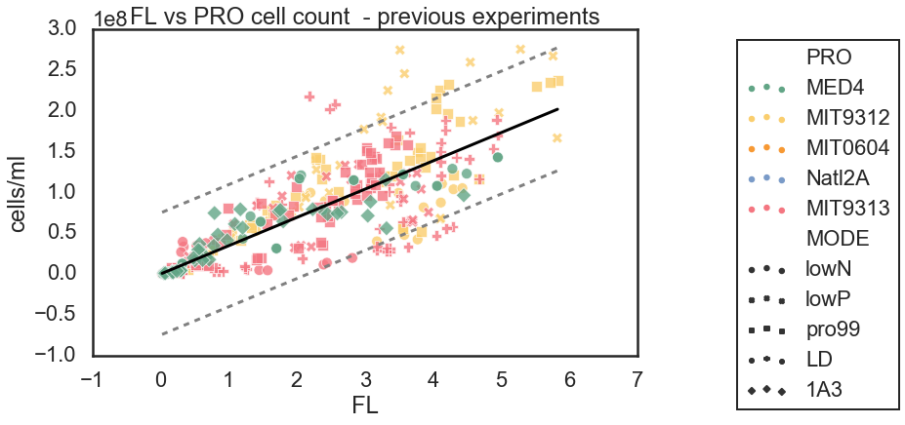
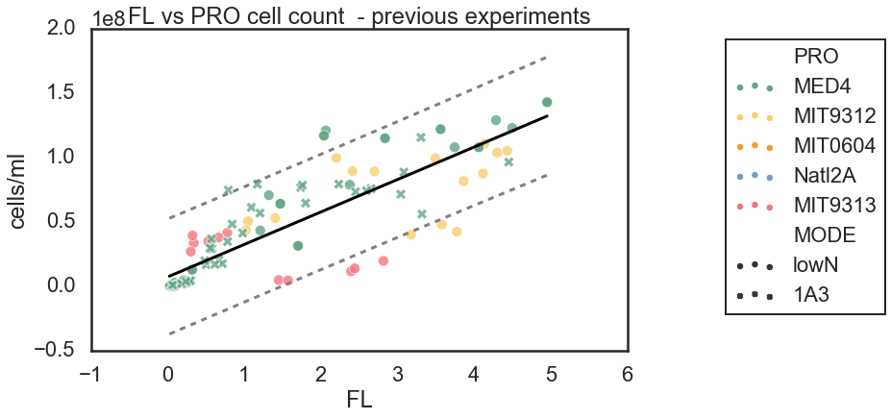
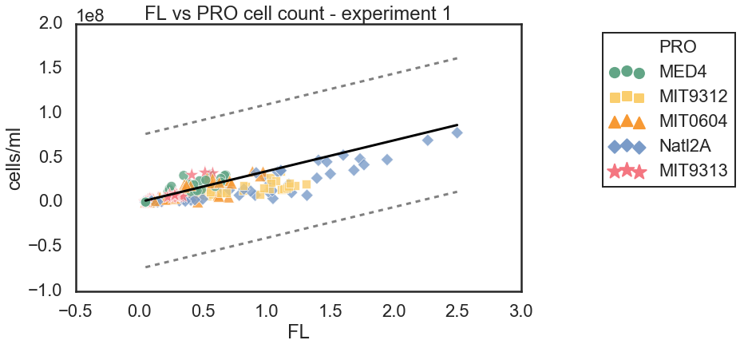
Figure S1
The graphs on the side are using all samples,
the graphs on the page are using only lowN and 1A3 samples
R² = 0.36
R² = 0.73
OLS Regression Results
=======================================================================================
Dep. Variable: FCM R-squared (uncentered): 0.849
Model: OLS Adj. R-squared (uncentered): 0.849
Method: Least Squares F-statistic: 1935.
Date: Tue, 10 Mar 2020 Prob (F-statistic): 4.53e-143
Time: 19:11:52 Log-Likelihood: -6491.9
No. Observations: 344 AIC: 1.299e+04
Df Residuals: 343 BIC: 1.299e+04
Df Model: 1
Covariance Type: nonrobust
==============================================================================
coef std err t P>|t| [0.025 0.975]
------------------------------------------------------------------------------
FL 3.464e+07 7.88e+05 43.987 0.000 3.31e+07 3.62e+07
==============================================================================
Omnibus: 22.969 Durbin-Watson: 0.978
Prob(Omnibus): 0.000 Jarque-Bera (JB): 53.226
Skew: 0.308 Prob(JB): 2.77e-12
Kurtosis: 4.826 Cond. No. 1.00
==============================================================================
Warnings:
[1] Standard Errors assume that the covariance matrix of the errors is correctly specified.

Slide 7
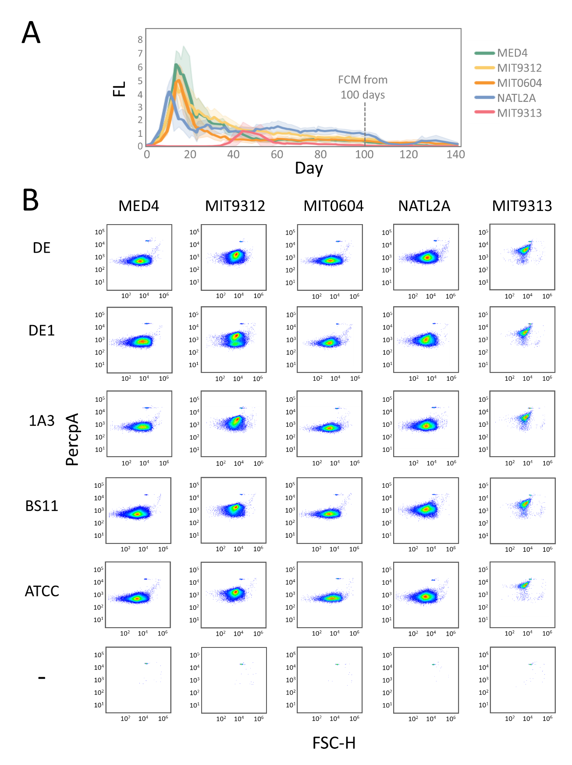
Figure S2

Slide 8
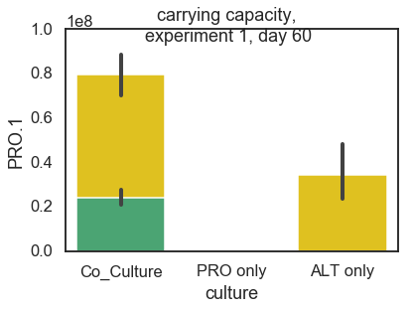
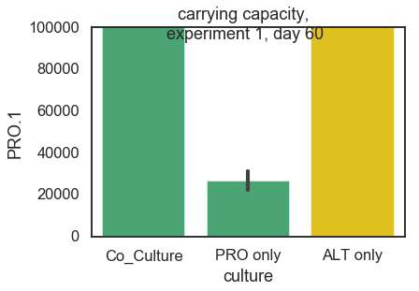
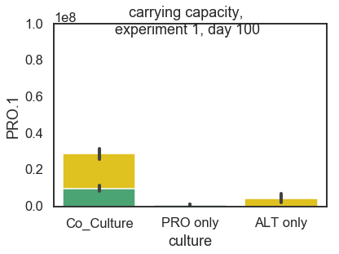
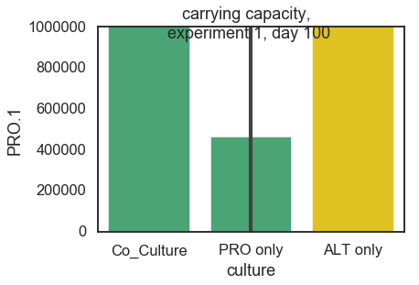
Figure S? Carrying capacity

Slide 9
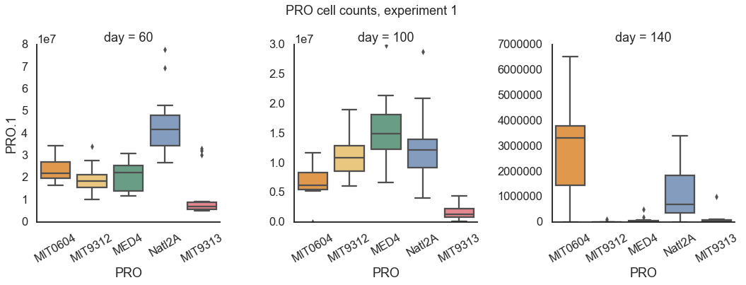
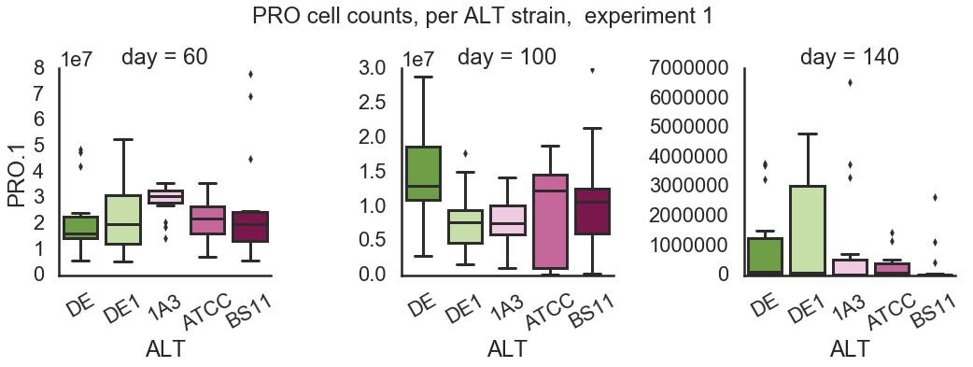
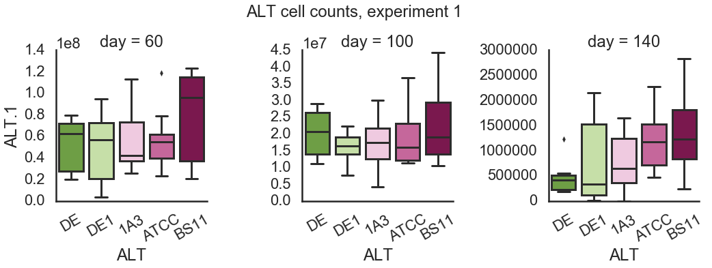
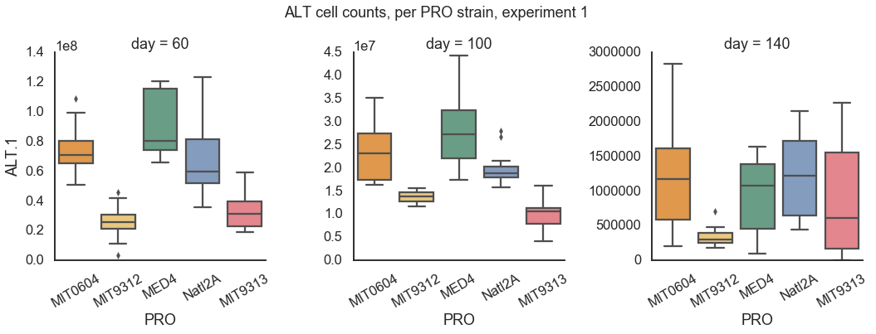
Figure S4
A
A
A
B
A
AB
AC
C
AC
B
B
A
A
A
A
A
A
A
A
A
A
A
A
A
A
A
A
A
A
A
AB
A
AB
AB
B
A
A
A
A
A
A
AB
AB
B
B
A
C
B
A
C
AB
C
A
B
C
A
B
AB
A
AB

Slide 10
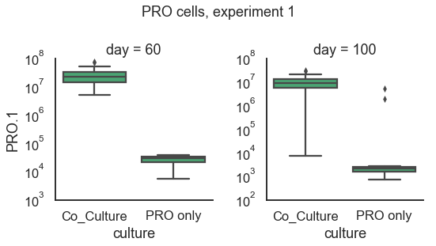
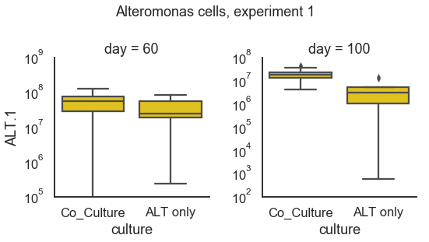
Figure S6

